Slide 1
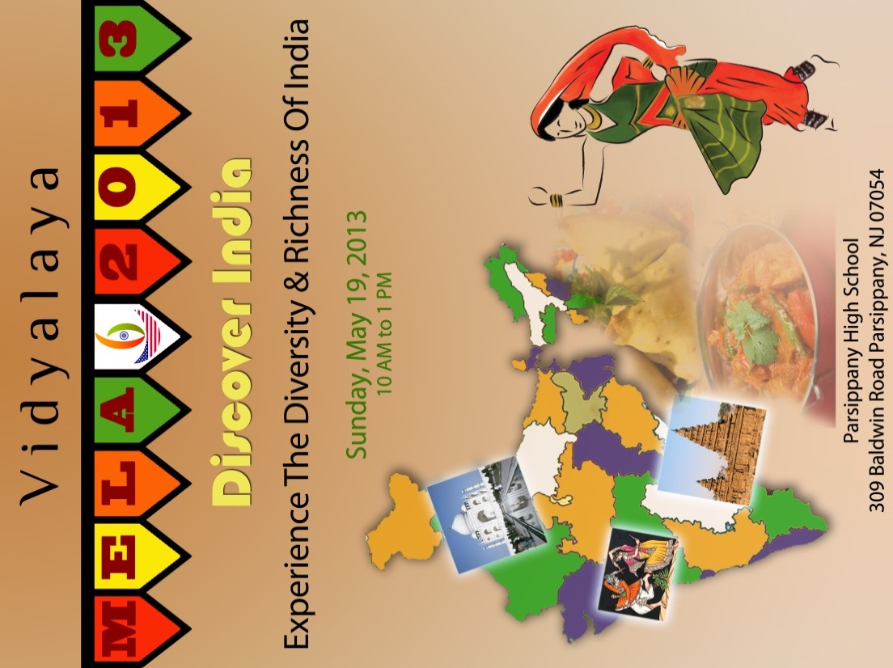
Culture 8 - National Capital Territory of Delhi
Culture 6B - Goa
Culture 9 - Maharashtra
Culture 7 - Jammu and Kashmir
Culture 7 - Jammu and Kashmir
Culture 9 - Maharashtra
Culture 6B - Goa
Culture 8 - National Capital Territory of Delhi

Slide 2
Culture 2B - Assam
Culture 1B - Uttar Pradesh / Uttarakhand
Culture KG - Madhya Pradesh
Culture 4A Rajasthan
Culture 5A - Punjab
Culture 6A - Gujarat
Culture 3A - Karnataka
Culture 2A - West Bengal
Culture 1A - Orissa
Culture 3B - Andhra Pradesh
Culture 4B - Tamil Nadu
Culture 5B - Kerala
Culture 5B - Kerala
Culture 4B - Tamil Nadu
Culture 3B - Andhra Pradesh
Culture 1A - Orissa
Culture 2A - West Bengal
Culture 3A - Karnataka
Culture 6A - Gujarat
Culture 5A - Punjab
Culture 4A Rajasthan
Culture KG - Madhya Pradesh
Culture 1B - Uttar Pradesh / Uttarakhand
Culture 2B - Assam

